Slide 1
Boxscore Bot
Eli Pappas & Nikhil Gupta
Advisor: Professor Giovani Abuaitah

Slide 2

Goals
This project was started as a way to generate valuable and accurate projections for NBA player statistics such as points, rebounds, and assists. This can be extremely valuable due to the nature of sportsbooks which simply set lines at where people will bet both sides, not where the actual projection for players is. Our models allow us to find what we believe to be bad lines and make recommendations based off that. This project could also provide value to team managers who need to decide which player will provide more team value in a given game.
This project was started with a few specific goals in mind:
Generate accurate projections
Provide an easy to navigate website to look through the projections
Analyze projections and navigate trends in the data

Slide 3

Intellectual Merits
This project allows for an interesting dive into sports data which often can be sporadic and random at times. We have both seen the application of machine learning to game outcomes, but we branched out and attempted a true number generation for player stats which we haven't seen done.
We are utilizing a couple different machine learning models such as a recurrent neural net (RNN) and XGBoost. We initially relied on simple linear regression (LR), binary classifier, and random forest. We are combining all these models to create an ensemble.
This project has required us both to learn more about ML and specific models as well as to learn more tools which we foresee ourselves utilizing in industry such as Postgres.

Slide 4

Broader Impacts
Impact on Sports Management Decisions
Provides insights into how players perform against specific teams or team types
Incorporates advanced statistics such as:
Pace
Defensive rating
Offensive rating
Helps evaluate factors that influence player performance
Supports more informed and strategic decision-making
Impact on the Betting Industry
Educates bettors with data-driven insights
Helps guide betting decisions with relevant performance metrics
Reduces the need for extensive independent research
Enables more informed, evidence-based choices

Slide 5
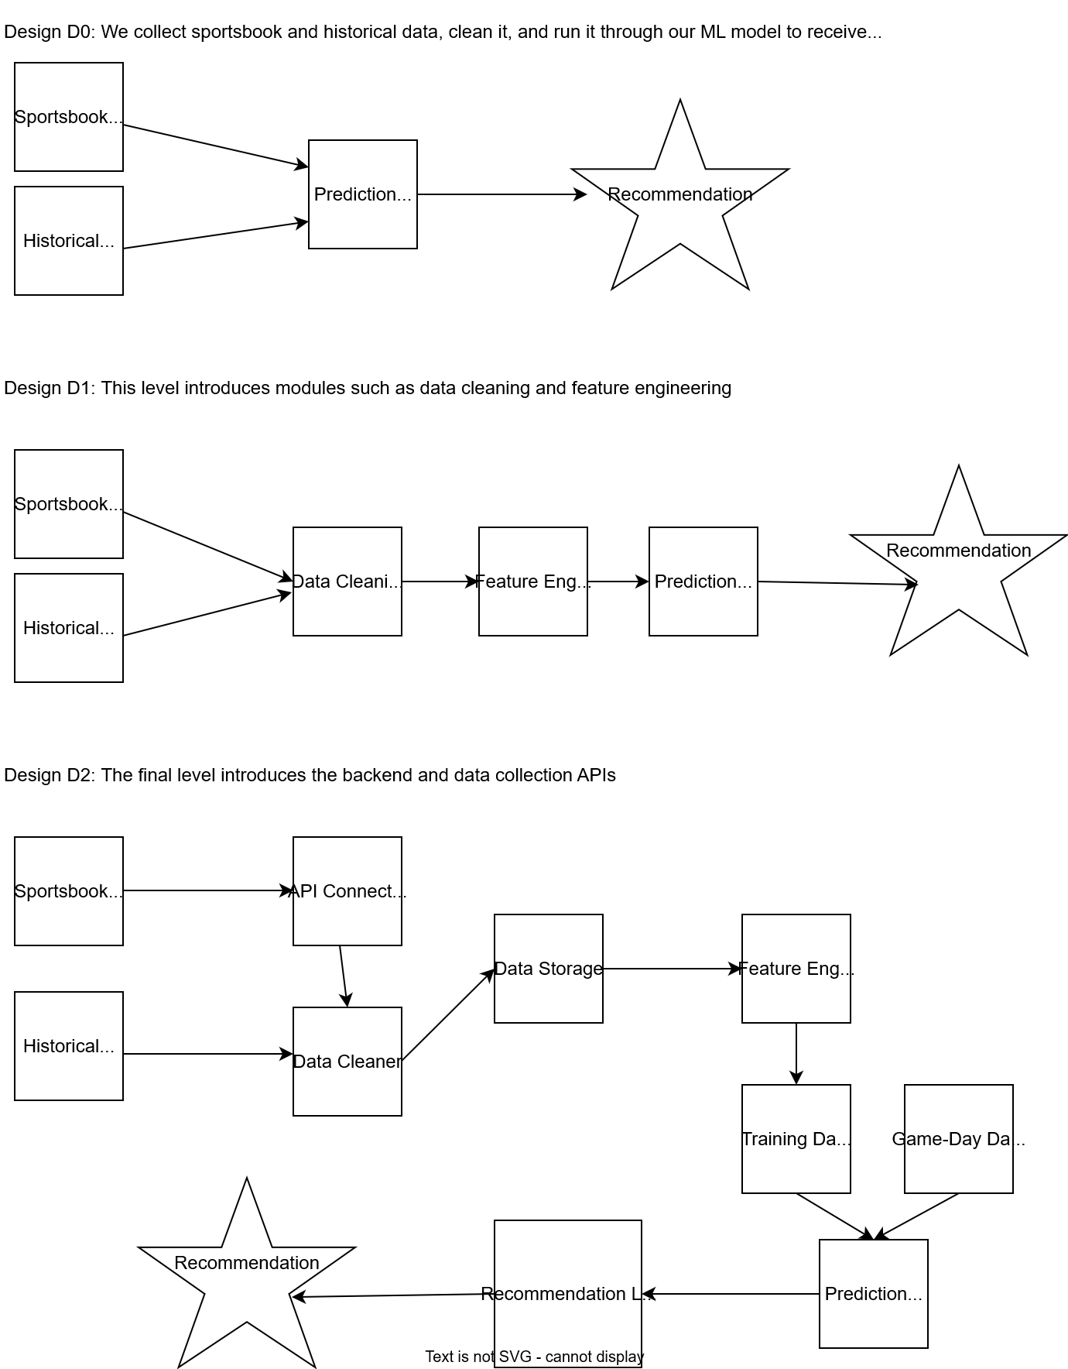
Design Specifications
Our project is designed in stages and in both back-end and front-end:
Data collection: We get our player data from a Kaggle dataset which is free and easy to get by running a script which we created. Sportsbook data comes from an API which we have a limited number of tokens for so it is used minimally.
Data cleaning: Included in the collection script is a cleaning function which removes retired players and any non regular-season or post-season games to cut down the file size only to data we deem valuable.
Model training: We have multiple files for individual models, the one used most often is the RNN which we can train or run the saved model to save time on.
Database: After the model generates the projections they are saved to a csv which is uploaded to a Supa Base database and then grabbed from there by the website.
The website is our forward facing portion of the data which displays all projections in a table which is searchable and sortable.

Slide 6

Technologies
The specific technologies used for this project can be broken into several categories :
IDE
Visual Studio Code
Programming Languages
Python (pandas, scikit-learn) – ML Model Training and Data Cleaning/Update Automation
Next.js & React – Frontend UI and Web Development
Jupyter Notebook – ML Model Training and Dimensionality Reduction
ML Models
XGBoost
Recurrent Neural Network
Version Control
GitHub

Slide 7

Milestones
Our primary goal for each players’ projections is to achieve at least 60% accuracy before the Expo so that we can display that the app has some foundational reliability. We are still working on tweaks to improve the model and training to achieve and surpass that benchmark.
Our secondary goal is to provide users with a easy-to-use interface that gives them as much information as they need to see how players are expected to do over the course of the season. We have a couple extra features planned for this if we have extra time such as individual player profiles that give in-depth looks for each players’ predicted stats.

Slide 8

Results
We made good progress since we started implementation last semester:
We implemented a Recurrent Neural Network and XGBoost model where the combined prediction between the two models’ outputs for each statistic
Current accuracy is averaging 50%
We automated the scripts to update the data with each night of new NBA games to feed into the models
Planning to account for outlier statistics like injuries into training to ground over optimistic predictions
UI and website is complete, with a landing page, projection table, projection history and sports line recommendations fully implemented
Projection Table houses all player projections for their most important stats like Points, Assists, Rebounds and PRA (combination of all three to measure overall impact on game)
Projection History displays bar chart distribution of each stats past predictions
Recommendations gives an over/under evaluation by comparing our predictions to official sports line betting predictions to give viewers a full range of where each player’s performance is projected

Slide 9

Challenges
Our biggest challenge was with the API and data source
Finding a reliable data source was initially difficult, with some requiring payment for tokens to access stats, and others not up to date with the current season’s games and active players
We found a good source from Kaggle, containing all the player statistics we need to properly train our models, and it would continuously update with new game stats throughout the season
The API for tracking active NBA players this season was also a challenge to work with, since there was an incident where someone outside changed the logic of one of the API getter functions, temporarily breaking our project
We eventually were able to work around this and revert the logic back, but it was a necessary warning sign that we should account for sudden API changes that could stop our app from functioning.
The current challenge we’re working on is improving the model accuracy. Our models are currently reaching 50% accuracy, which isn’t very helpful on indicating how a player will improve over the season. We are currently investigating new training techniques and data cleaning tweaks to push our models to their fullest potential.

Slide 10
Demo

